Slide 1
Bayesian Learning
Parinya Sanguansat

Slide 2
Bayesian Learning
Probabilistic approach to inference
Based on the assumption that:
  Quantities of interest are governed by probability distributions
  Optimal decisions can be made by reasoning about these probabilities together with observed data.

Slide 3
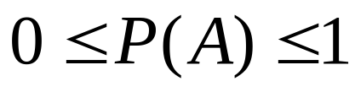
Probability
All probabilities between 0 and 1
True proposition has probability 1, false has probability 0
P(true) = 1 P(false) = 0
Union
Disjunction
Marginal
Marginal
Joint
Conjunction

Slide 4
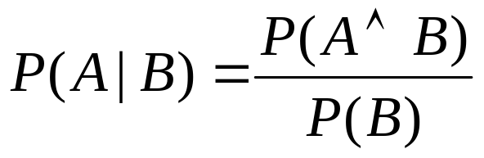
Conditional Probability
P(A | B) is the probability of A given B
Assumes that B is all and only information known.
Defined by:

Slide 5


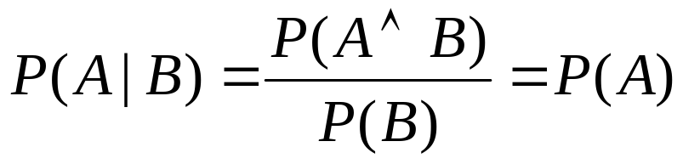
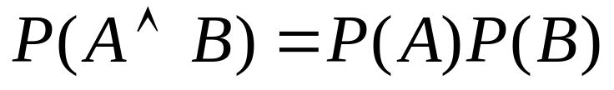
Independence
A and B are independent iff:
Therefore, if A and B are independent:

Slide 6
Conditional Probability
1
2
P(pill) =
P(capsule) =
P(1) =
P(2) =
P(pill | 1) =
P(capsule | 1) =
P(1 | pill) =
P(1 | capsule) =
P(pill | 2) =
P(capsule | 2) =
P(2 | pill) =
P(2 | capsule) =

Slide 7
Example
If you draw 2 cards from the deck without replacement, what is the probability that they will both be aces?
If you draw 3 cards from the deck with replacement, what is the probability that they will be all aces?
What is the probability that the second card will be an ace if the first card is a king?
Notes:
P(AA)= (4/52)(3/51)
P(AAA)= (4/52)(4/52) (4/52)
P(A|K)=4/51

Slide 8



Example
Like or dislike the designs
Which is the popular design? Can you prove it?
Find these probabilities
like
dislike
 | circle | square
red | 0.20 | 0.02
blue | 0.02 | 0.01
 | circle | square
red | 0.05 | 0.30
blue | 0.20 | 0.20

Slide 9
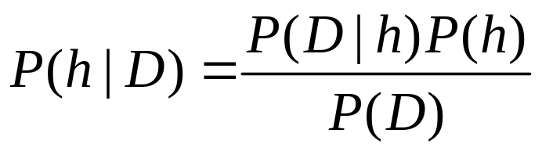




Bayes Theorem
Evidence : Prior probability of training data D
Prior : Prior probability of hypothesis h
Posterior : Posterior probability of hypothesis h given the data D
Likelihood : Posterior probability of data D given the hypothesis h

Slide 10
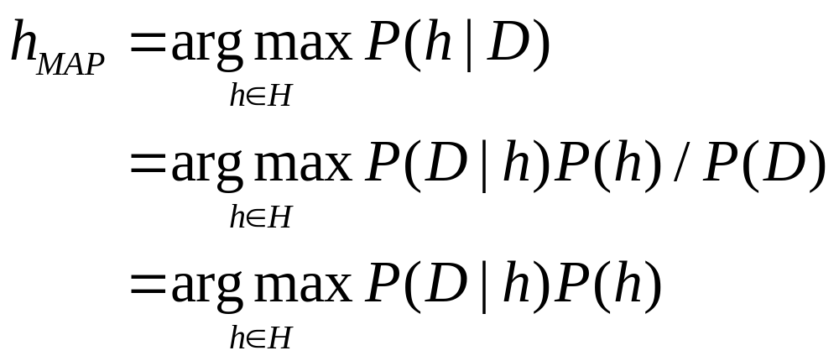
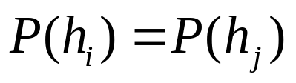
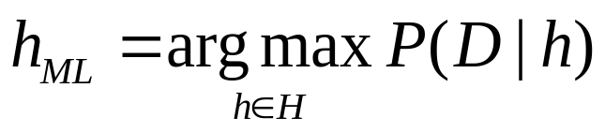
How to choose hypotheses?
Generally, we want the most probable hypothesis given the training data maximum a posteriori hypothesis
If the priors of hypothesis are equally likely then one can choose the maximum likelihood hypothesis
Constant independent of h

Slide 11
Example
What is chance to play tennis on sunny day?
Day Outlook Temp Humidity Wind Play Tennis
1 Sunny Hot High Weak No
2 Sunny Hot High Strong No
3 Overcast Hot High Weak Yes
4 Rain Mild High Weak Yes
5 Rain Cool Normal Weak Yes
6 Rain Cool Normal Strong No
7 Overcast Cool Normal Strong Yes
8 Sunny Mild High Weak No
9 Sunny Cool Normal Weak Yes
10 Rain Mild Normal Weak Yes
11 Sunny Mild Normal Strong Yes
12 Overcast Mild High Strong Yes
13 Overcast Hot Normal Weak Yes
14 Rain Mild High Strong No
Notes:
P(Sunny) = 5/14
P(Yes) = 9/14
P(Sunny|Yes) = 2/9
P(Yes|Sunny) = P(Sunny|Yes)P(Yes)/P(Sunny) = (2/9*9/14)/(5/14) = 2/5
P(Yes|Sunny) = 2/5

Slide 12
Example
Medical diagnosis problem
H = {cancer, ~cancer}
D = {positive, negative} (imperfect lab test)
Prior knowledge
  0.008 of entire population have cancer
  Lab test correct positive 98%
  Lab test correct negative 97%
What is the chance that the new patient have cancer, if the lab test return the positive result?
Notes:
P(+|cancer)P(cancer)=.98*.008=.0078
P(+|~cancer)P(~cancer)=.03*.992=.0298 ← hMAP
P(+) = 0.0078+0.0298
P(cancer|+) = P(+|cancer)P(cancer)/P(+) = .21

Slide 13
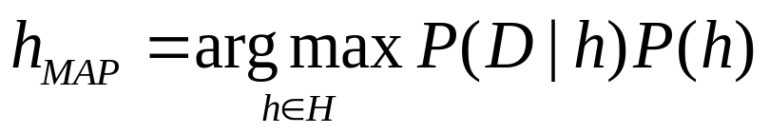
Brute-Force MAP Learning Algorithm
For each hypothesis h in H, calculate the posterior probability
Output the hypothesis with the highest posterior probability

Slide 14




Evolution of Posterior Probabilities

Slide 15
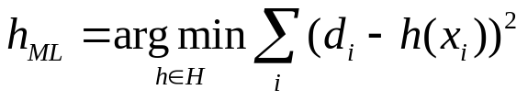
Learning a Real Valued Function
In real values function, we cannot estimate the probability by counting
  Pixel intensity, amplitude, frequency, time, etc.
Consider a real-valued target function f
Noisy training examples <x_{i},d_{i}>: d_{i} = f(x_{i}) + e_{i}
  e_{i} is a random variable drawn from a Gaussian distribution with zero mean.
f
e

Slide 16
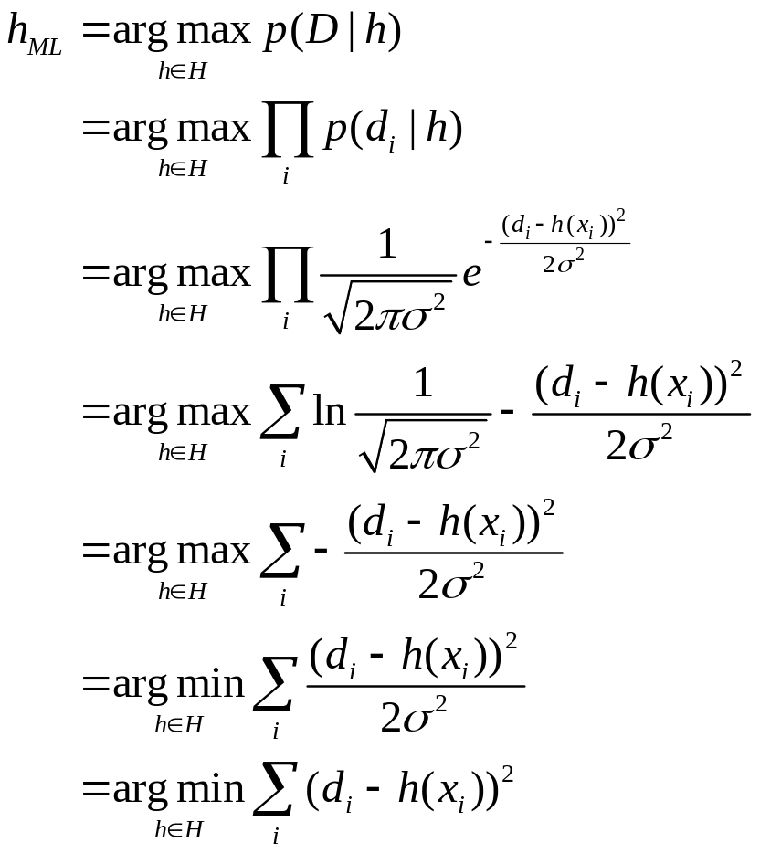
Learning a Real Valued Function
Approximate the probability distribution is normal

Slide 17
Most Probable Classification
h_{MAP} is not the most probable classification, although often a sufficiently good approximation of it.
Consider three possible hypotheses:
  P(h₁|D) = 0.4, P(h₂|D) = 0.3, P(h₃|D) = 0.3
Given a new instance x
  h₁(x) = +, h₂ (x) = -, h₃ (x) = -
  h_{MAP}(x) = +
What is most probable classification of a new instance x given the data D?
  P(+) = P(h₁|D) = 0.4
  P(-) = P(h ₂|D) + P(h ₃|D) = 0.6
  h_{Most}(x) = -

Slide 18
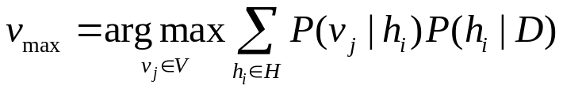
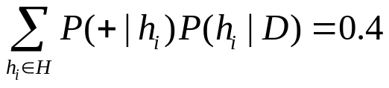
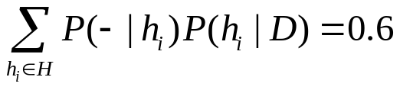
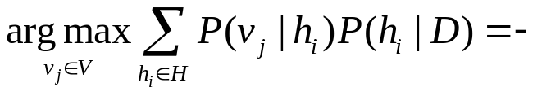
Bayes Optimal Classifier
Combine the predictions of all hypotheses, weighted by their posterior probabilities
Again:
  P(h₁|D) = 0.4, P(h₂|D) = 0.3, P(h₃|D) = 0.3
  h₁(x) = +, h₂ (x) = -, h₃ (x) = -
  P(+|h₁)=1, P(-|h₁)=0
  P(+|h₂)=0, P(-|h₂)=1
  P(+|h₃)=0, P(-|h₃)=1

Slide 19
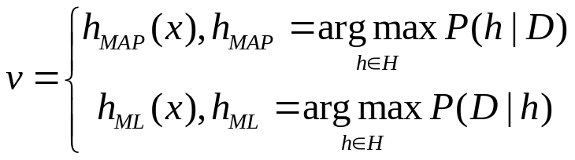
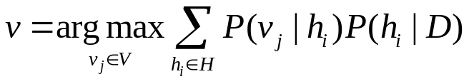
MAP vs ML vs Bayes Opimal Classifier
MAP/ML estimate a hypothesis in the hypothesis space H
Bayes method instead estimates and uses a complete distribution P(h|D)
The difference appears when they are used for inference of unseen instances and one compares the distributions P(x|D)
Bayes optimal classifier can prediction with a hypothesis not contained in H

Slide 20
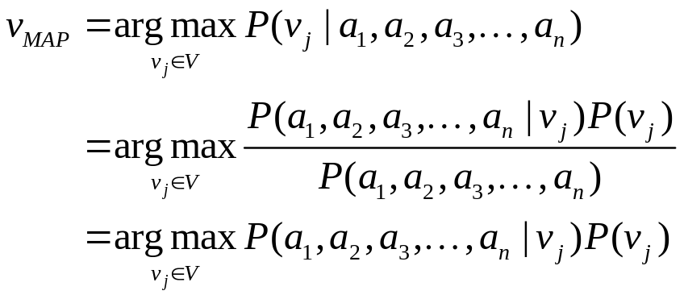
Practical Bayesian Learning
If we have only training data and targets, without any hypotheses
If we have a small training set, while the number of attributes of each data is more than 1.
How to use Bayesian learning?
Objective: Classify the new instance is to assign the most probable target value

Slide 21
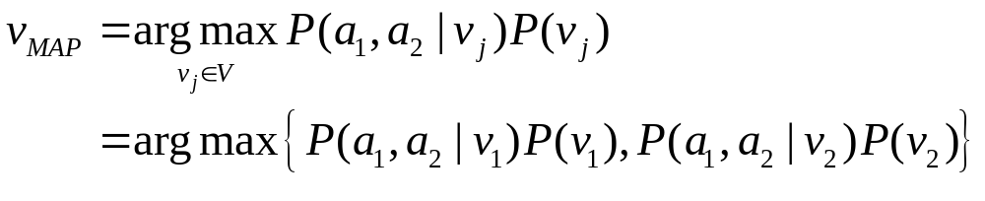


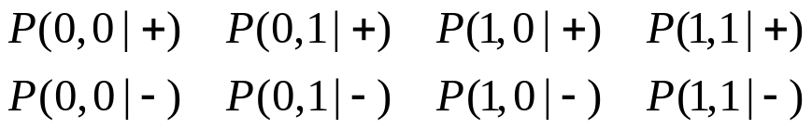



What is the problem?
If we have 2 boolean attributes and 2 boolean targets
All possible instances
Thus, we need to find all of these probabilities
What if we have n attributes with m values and t targets
  Ex: n=4, m=100, t =10 → we need to calculate 1,000,000,000 !!!
  And we need the at least 100,000,000 sample to train

Slide 22
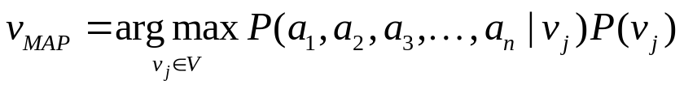
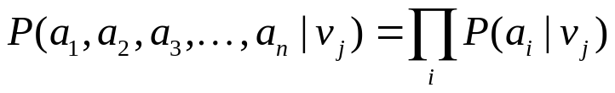
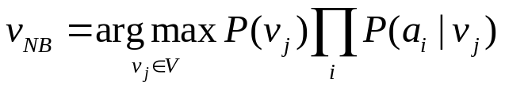
Naïve Bayes Classifier
Classify the new instance is to assign the most probable target value
Naïve Bayes assumption:
  The attribute values are conditionally independent given the target value
  Ex: n=4, m=100, t =10 → we need to calculate only 4,000 !!!

Slide 23
Naïve Bayes Classifier
Popular, simple learning algorithm
Moderate or large training set available
Assumption: attributes that describe instances are conditionally independent given classification
  in practice works surprisingly well even if assumption is violated
Applications:
  diagnosis
  text classification

Slide 24
Naïve Bayes Learning Algorithm
Learn
  For each target value v_{j}
    Estimate P(v_{j}) by
      If discrete value, count the number of examples in v_{j}
      If continuous value, use pdf
  For each attribute value a_{i}
    Estimate of each attribute a estimate P(a_{i}|v_{j})
      If discrete value, count the number of examples in v_{j}
      If continuous value, use pdf
Classify

Slide 25

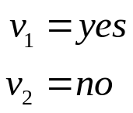

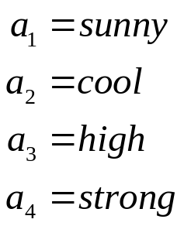
Naïve Bayes Example
<Outlook=Sunny, Temp=cool, Humidity=high, Wind=strong> = ?
Day Outlook Temp Humidity Wind Play Tennis
1 Sunny Hot High Weak No
2 Sunny Hot High Strong No
3 Overcast Hot High Weak Yes
4 Rain Mild High Weak Yes
5 Rain Cool Normal Weak Yes
6 Rain Cool Normal Strong No
7 Overcast Cool Normal Strong Yes
8 Sunny Mild High Weak No
9 Sunny Cool Normal Weak Yes
10 Rain Mild Normal Weak Yes
11 Sunny Mild Normal Strong Yes
12 Overcast Mild High Strong Yes
13 Overcast Hot Normal Weak Yes
14 Rain Mild High Strong No
Notes:
P(yes) = 9/14*2/9*3/9*3/9*3/9 = 0.005
P(no) = 5/14*3/5*1/5*4/5*3/5 = 0.021

Slide 26
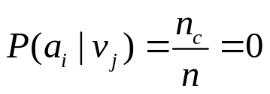
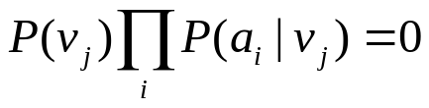
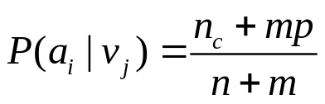
M-estimate of probability
What if none (n_{c}=0) of the training instances with target value v_{j} have attribute a_{i}?
  and
Solution: m-estimate of probability
  n: number of training examples for which v=v_{j}
  n_{c}: number of examples for which v=v_{j} and a=a_{i}
  p: prior estimate of P(a_{i}|v_{j})
  m: weight given to prior (number of “virtual” examples)

Slide 27
Naïve Bayes: Text categorization
Classify the topic of the document
  Input = document
  Output = topic
For Naïve Bayes,
  Instance = ?
  Attribute = ?
  Target = ?

Slide 28
Naïve Bayes: Text categorization
“Australia completed a comprehensive victory over England in the fourth Ashes Test at Headingley, Leeds, winning by an innings and 80 runs inside three days to level the series at 1-1 with just the deciding Test match at The Oval still to play.”
Instance = Document
Attribute = index and frequency of each word.
  < Australia, completed, …>
  Use random variable for mapping each word to index
  Count the frequency of each word in each document
Target
  {Sport, Politic, Entertainment, …}

Slide 29
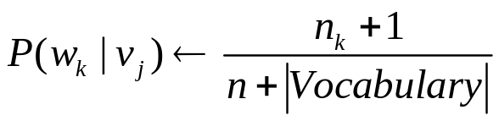
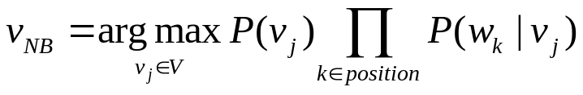
Naïve Bayes: Text categorization
Learn_naive_Bayes_text(Examples, V)
  Vocabulary ← all distinct words in Examples
  For each target value v_{j} in V do
    P(v_{j}) ← |docs_{j}| / |Examples|
    text_{j} ←concatenating all members of docs_{j}
    n ← total number of words in text_{j}
    For each word w_{k} in Vocabulary
      n_{k} ← number of times word w_{k} occurs in text_{j}
Classify_naive_Bayes_text(Doc)
  Position ← all word positions in Doc that contain tokens in Vocabulary
  Return

Slide 30
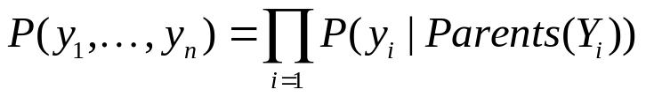
Bayesian Belief Networks
Naïve Bayes: All variables are conditionally independent
BBN: Some variables are conditionally dependent
  Less constrain, Naïve assumption of conditional independency too restrictive
  Still tractable, Full probability distribution intractable due to lack of data
  Allows combining prior knowledge about causal relationships among variables with observed data
Representation

Slide 31
Conditional Independence
Definition: X is conditionally independent of Y given Z is the probability distribution governing X is independent of the value of Y given the value of Z
P(X|Y,Z) → P(X|Z)
Naïve Bayes uses conditional independence to justify:
  P(X,Y|Z) = P(X,Y,Z)/P(Z)
  = P(X|Y,Z)P(Y,Z)/P(Z)
  = P(X|Y,Z) P(Y|Z)
  = P(X|Z) P(Y|Z)

Slide 32
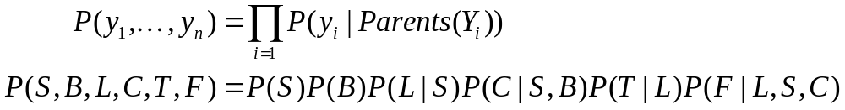
Example: BBN
Network represents joint probability distribution over all variables
Each node is conditionally independent of its non-descendants, given its immediate predecessors. (directed acyclic graph)
Storm
BusTourGroup
Campfire
Lightning
Campfire
 | S,B | S,~B | ~S,B | ~S,~B
C | 0.4 | 0.1 | 0.8 | 0.2
~C | 0.6 | 0.9 | 0.2 | 0.8
Thunder
ForestFire

Slide 33
Inference in Bayesian Networks
How can one infer the probabilities of values of one or more network variables given observed values of others?
The inference can be straightforward if we can observe all the information needed for this inference.
If only some variables with unknown value, use pdf
In the general case, inference in Bayesian networks is NP-hard problem
In practice exact inference methods work well for some network structures
Monte Carlo methods simulate the network randomly to calculate approximate solutions

Slide 34
Learning Bayesian Networks
Suppose structure is known, variables are partially observable, e.g.
  Observable: Forestfire, Storm, BusTourGroup, Thunder
  Unobservable: Lightning, Campfire
Similar to train neural network with hidden units
Learn conditional probability tables using gradient ascent
Converge to network h that (locally) maximizes P(D|h)

Slide 35
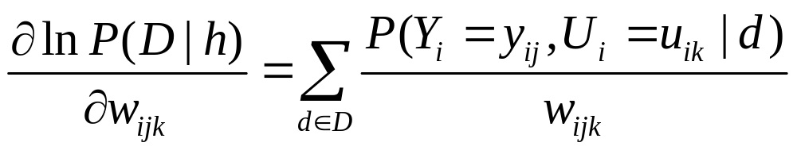
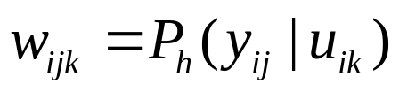
Gradient Ascent Training of BBN
Given
  D = Training data
  Y = Network variable
  U = Y’s immediate parents
  e.g. y = T, u = <F,F>
Maximum likelihood
Storm
BusTourGroup
Campfire
 | S,B | S,~B | ~S,B | ~S,~B
C | ? | ? | ? | ?
~C | ? | ? | ? | ?

Slide 36
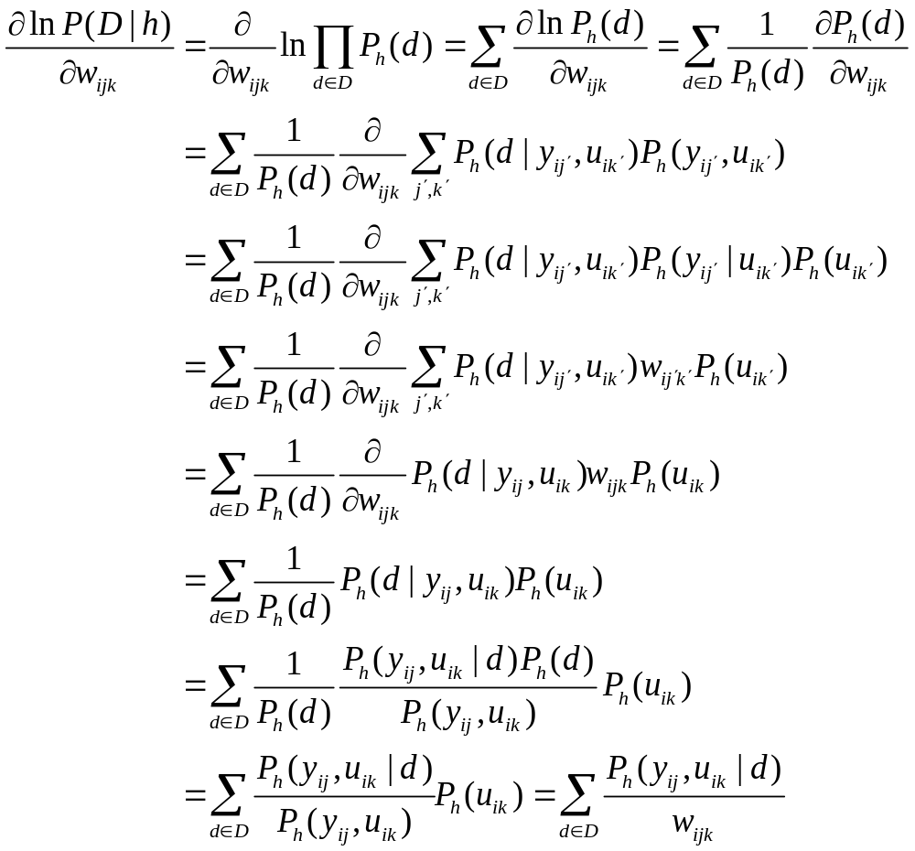
Derive: Gradient Ascent Training of BBN
ML:

Slide 37
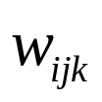


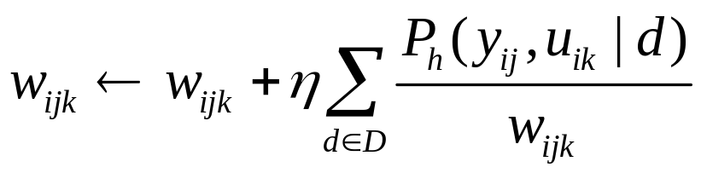
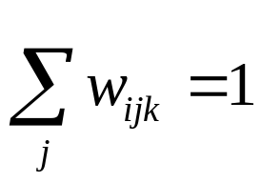
BBN: Training Algorithm
Let denote one entry in the conditional probability table for variable in the network
Perform gradient ascent on by repeatedly
Update all using training data D
Renormalize the to assure

